Slide 1
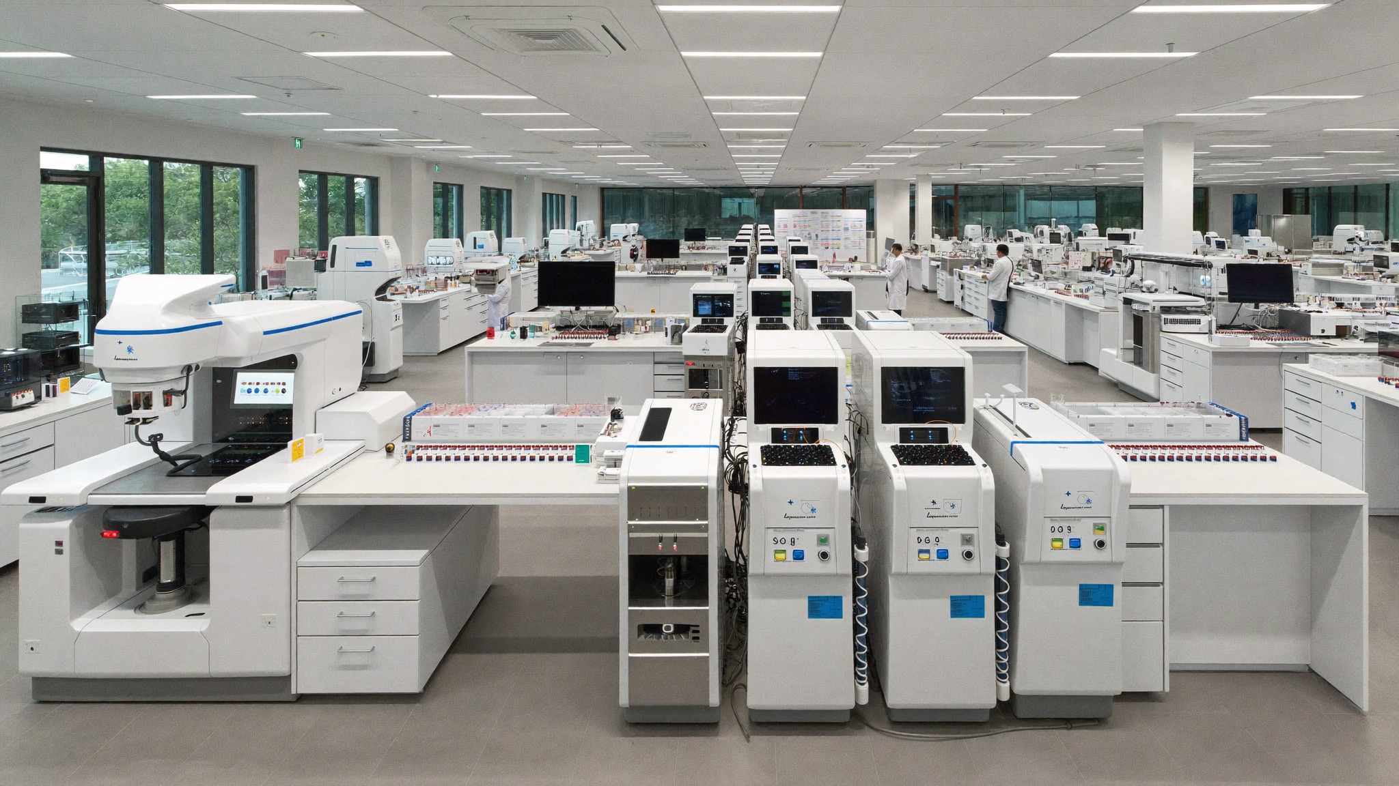
BURJEEL AFRICA EXPANSION
Owning the diagnostic
backbone of a continent
One repeatable lab unit. A government-backed network.
A board-level proposal for Dr. Shamsheer.
Strictly internal — Highly confidential · Roche × Burjeel × AD Ports · 22 June 2026
Notes:
Headline options: 1) Owning the Diagnostic Backbone of a Continent [REC] 2) One Lab Model. Fifty-Four Nations. 3) Built Once, Deployed Everywhere.
Photo: Higgsfield Soul — African lab scientist, no real person.

Slide 2
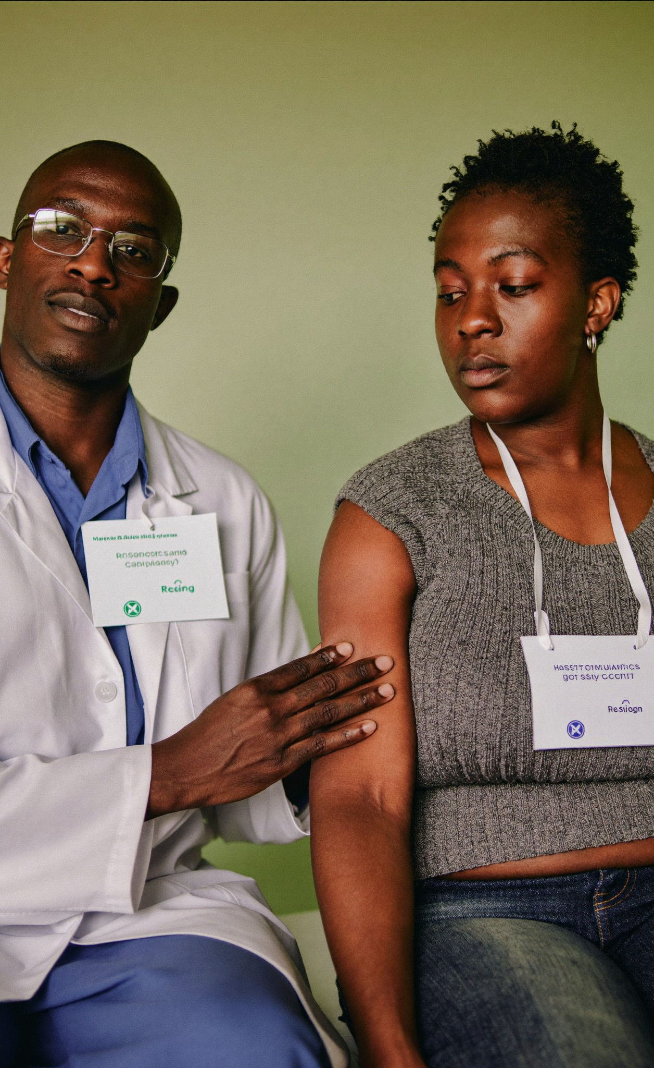
THE SITUATION
The diagnosis never comes
Across Africa, the first step in care — a test — is the step most often missing.
47%
81%
of the world has little to no access to diagnostics
in low-income countries — diagnosis simply isn't available
~94%
Highest
of the world's malaria cases are in the WHO African Region
Africa carries the world's heaviest TB / HIV burden
Sources: Lancet Commission on Diagnostics 2021; WHO Afro (malaria 2022, TB 2024).
Notes:
Headlines: 1) The Diagnosis Never Comes [REC] 2) Half the World Can't Get a Basic Test 3) Where Medicine Goes Blind.

Slide 3
THE OPPORTUNITY
A $1.4bn market with no
one in charge
Africa IVD market, USD bn
$1.91bn
$1.38bn
Africa's diagnostics market is real, growing — and split across 54 nations with no integrated operator. Whoever industrialises it first defines the category.
$345M→$677M
molecular diagnostics, 2024–33
54 / 0
nations served / integrated operators today
2025
2034
3.7% CAGR · Source: Africa IVD Market Report, 2025–34
Notes:
Headlines: 1) A $1.4bn Market With No One in Charge [REC] 2) Small, Fragmented, Waiting to Be Industrialised.
'15 nations=80%' from original deck OMITTED — unsourced.

Slide 4
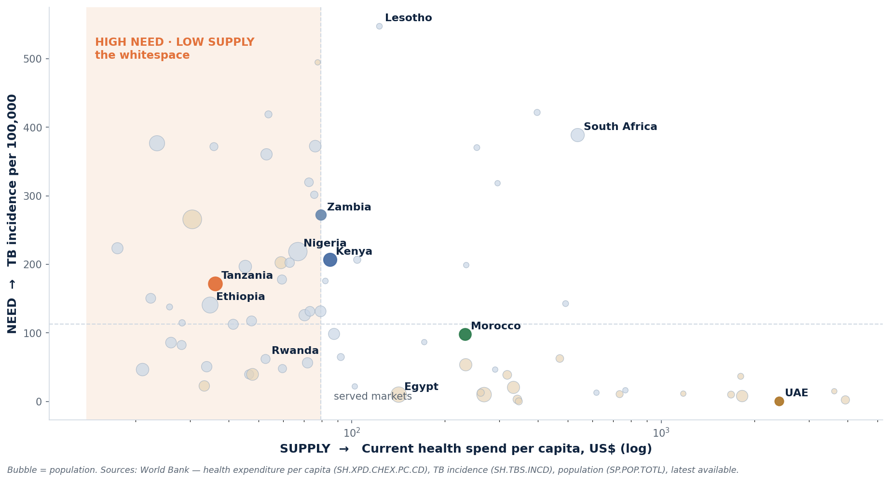
THE OPPORTUNITY, QUANTIFIED
The whitespace: high need, low supply
71 of the ~84 Africa + Middle East nations with complete World Bank data. Tanzania sits in the high-need / low-supply quadrant — the pilot thesis, quantified.
Notes:
NEW analytics — World Bank indicators: health spend per capita (supply), TB incidence (need), population (bubble).

Slide 5
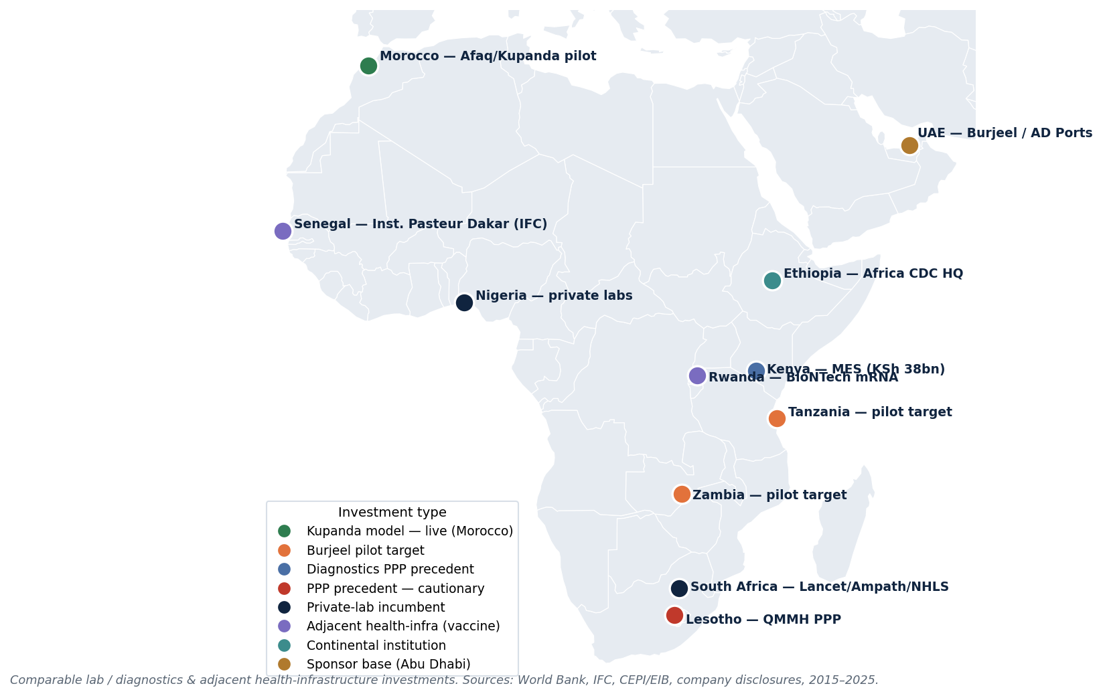
THE COMPETITIVE LANDSCAPE
Where the diagnostic capital is going
Capital clusters in vaccines (Rwanda, Senegal) and incumbent private labs (South Africa). No one has built the repeatable diagnostic network — the gap Burjeel fills.
Notes:
NEW — comparable lab/diagnostics & adjacent health-infra investments, geo-plotted.

Slide 6
THE ANSWER
One unit, not fifty-four bespoke builds
The “Kupanda” Scalable Unit — four stacked layers, deployed identically into any market.
1
Roche analytics & reagents
Core. The maximised Roche portfolio on a reagent-rental model — zero up-front capex for the operator.
2
Pan-pathology managed services
Closes menu gaps with managed third-party procurement at a transparent markup.
3
Turn-key laboratory
A ready-to-run lab, fitted out and billed as one monthly all-inclusive lease.
4
Additional services
IT networking, sample transport, accreditation and consultancy — sold as subscriptions.
Notes:
Genuine Roche source material. Headlines: 1) One Unit, Not Fifty-Four Bespoke Builds [REC].

Slide 7
PROVEN, THEN SCALED
One engine, two ways to deploy
LIVE NOW · MOROCCO
PROPOSED · BURJEEL
The cooperative model
The PPPP model
A single B2B “shared-utility” central lab
A national IVD network anchored by one hub lab
Serves competing private labs that co-operate on cost
Burjeel runs clinical ops; Roche deploys the unit
Operated by a registered local biologist
Long-range government concession agreement
Governance pushes margin out to the member labs
Funded by development finance / Abu Dhabi loans
Morocco proves the unit works. Burjeel scales it to a whole country — the leap this proposal underwrites.
Notes:
New slide — restores the original deck's two-model substance (Afaq/Morocco cooperative vs Burjeel PPPP).

Slide 8
WHY THIS ALLIANCE
Three partners, three risks removed
ROCHE
BURJEEL
AD PORTS
The technology risk
The operating risk
The access risk
World diagnostic menu, analytics and the reagent-rental engine — the clinical credibility.
Clinical operations at scale, founded 2007; a principal worth ~$2.4bn, driven by legacy.
Sovereign government access and the financing rails into Africa.
Dr. Shamsheer Vayalil, Founder & Chairman
Burjeel × AD Ports ‘DOCKTOUR’ JV, May 2025 · AD Ports = ADQ sovereign
Apart, none can enter Africa at scale; together, the entry is de-risked.
Notes:
Fact-checked: Burjeel est. 2007; Vayalil ~$2.4bn (2023); DOCKTOUR JV May 2025; AD Ports majority ADQ-owned.

Slide 9
HOW IT PAYS — AND WHY IT LASTS
A proven structure, with the failure modes designed out
THE PPPP MONEY-FLOW
THE EVIDENCE — BUILT IN
1
Government
✓
Kenya — it works
Concession + national IVD network
Managed Equipment Services: KSh 38bn, 98 hospitals across 47 counties on a 7-year lease (2015). The structure we adopt.
2
DFI / Abu Dhabi
Development finance & bilateral loans
3
Roche + Burjeel
Lesotho — how it dies
Deploy & operate the Kupanda unit
!
The IFC’s flagship health PPP cost $67m/yr — 51% of the health budget; terminated early. The failure mode we design out.
4
Revenue share
Across the whole network
Sources: World Bank & Parliament of Kenya (MES); Oxfam / PMC (Lesotho QMMH-IN).
Notes:
Dense precedent numbers added vs v1: Kenya KSh38bn/98 hospitals/47 counties; Lesotho $67m/yr=51% budget.

Slide 10
WHERE TO START
Start where it’s winnable
15 of 54 nations carry the bulk of the opportunity. Three are pilot-ready — for different reasons.
TANZANIA
KENYA
ZAMBIA
The preferred start
The established base
The dark horse
Easier business environment and strong sovereign-PPP commonalities. Tier-1 pilot target.
Highly developed regional infrastructure — but a crowded market to manoeuvre in.
Elevated after completing its 2024 debt restructuring (~40% cut on $6.3bn). Low competitive saturation.
Filtered on ease of doing business, legal frameworks and competitive saturation.
Notes:
New slide — restores geographic tiering with sourced Zambia restructuring factoid.

Slide 11

THE ASK
Greenlight one pilot:
Tanzania, twelve months
ONE MARKET
Tanzania — easier entry, sovereign-PPP fit
ONE DECISION
A single Go / No-Go at month 12
ONE NEED
Dr. Shamsheer’s mandate to co-develop
Small. Reversible. The cheapest way to test a continental thesis before committing.
Notes:
Headlines: 1) Greenlight One Pilot: Tanzania, Twelve Months [REC] 2) One Small, Reversible Bet.

