Slide 1
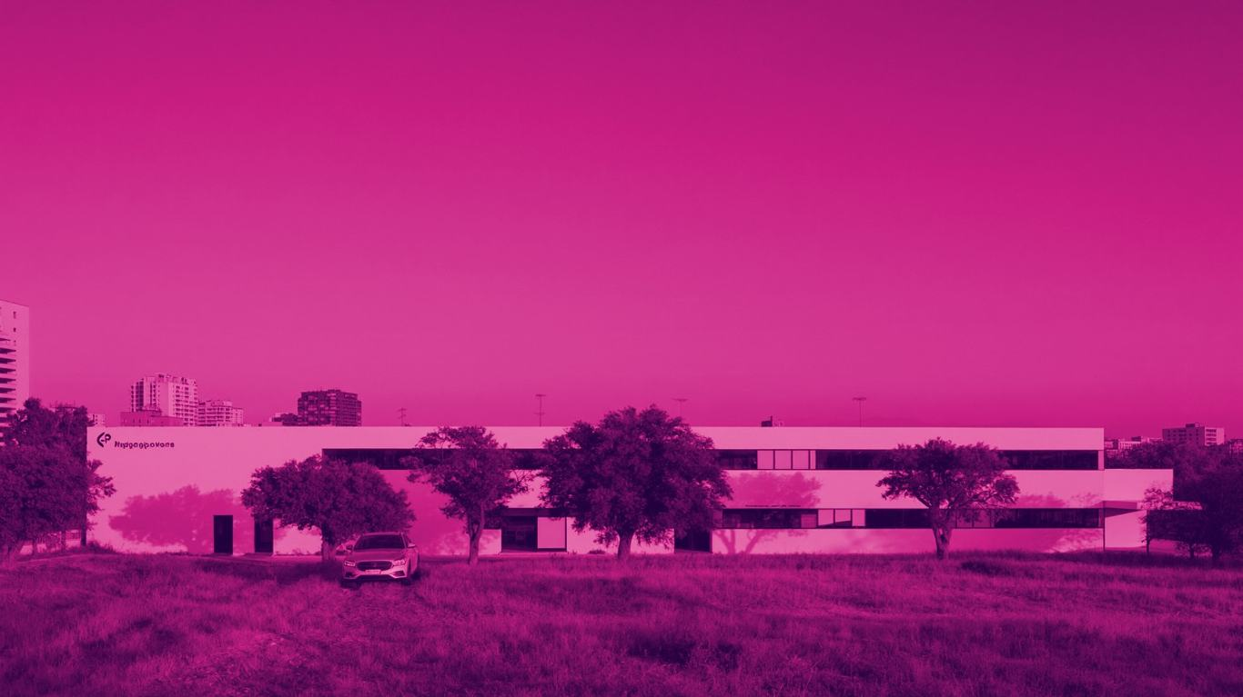
burjeel × roche
#DIAGNOSTICBACKBONE
OWNING THE
DIAGNOSTIC BACKBONE
OF A CONTINENT
A board pitch to build Africa's first repeatable, government-backed diagnostic network.
DR. SHAMSHEER Founder & Chairman, Burjeel Holdings

Slide 2


THE OPPORTUNITY
THE DIAGNOSIS
NEVER COMES
47%
lack access to essential diagnostics
81%
in low-income countries
94%
of malaria burden is in Africa

Slide 3

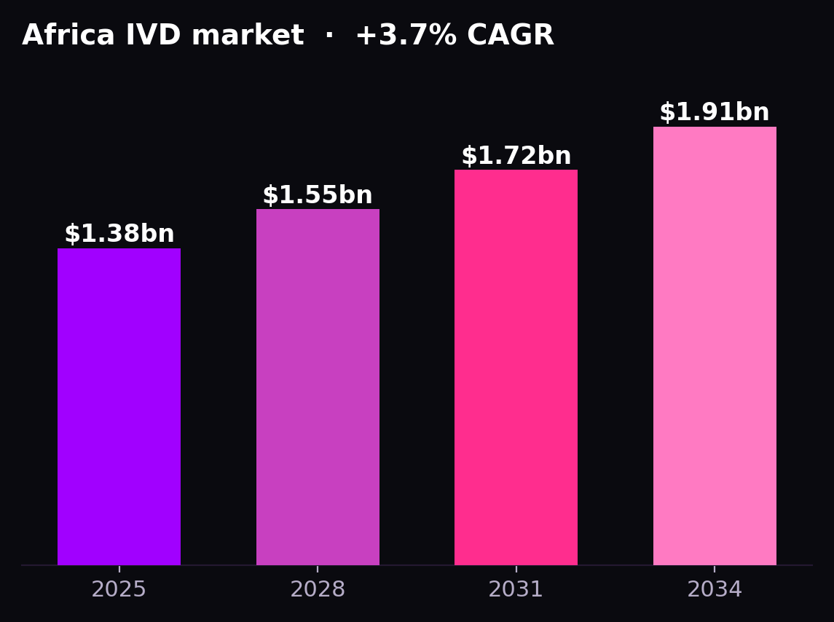
THE MARKET
A $1.9BN MARKET, NO OPERATOR
$1.38bn today → $1.91bn by 2034
Fragmented across 54 nations with no integrated diagnostic operator.

Slide 4

THE MODEL
THE KUPANDA UNIT — THREE RISKS REMOVED
ROCHE
BURJEEL
AD PORTS
Reagents & analysers on a rental model — removes the technology risk.
Operates the turn-key lab network — removes the operating risk.
Finance, logistics & access — removes the access & financing risk.

Slide 5
THE EVIDENCE
ONE MODEL WORKS. ONE FAILS.
KENYA — IT WORKS
LESOTHO — HOW IT DIES
Managed Equipment Services: 98 hospitals, 47 counties on a 7-yr lease. The structure we adopt.
IFC flagship PPP cost 51% of the health budget; terminated early. The failure mode we design out.

Slide 6

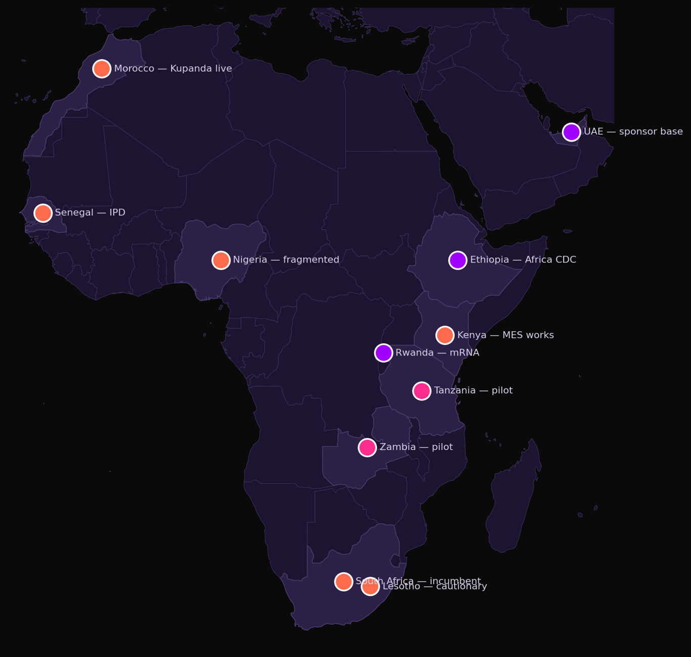
THE COMPETITIVE LANDSCAPE
WHERE THE CAPITAL IS GOING
Capital clusters in vaccines and incumbent private labs.
No one has built the repeatable network — the gap Burjeel fills.

Slide 7
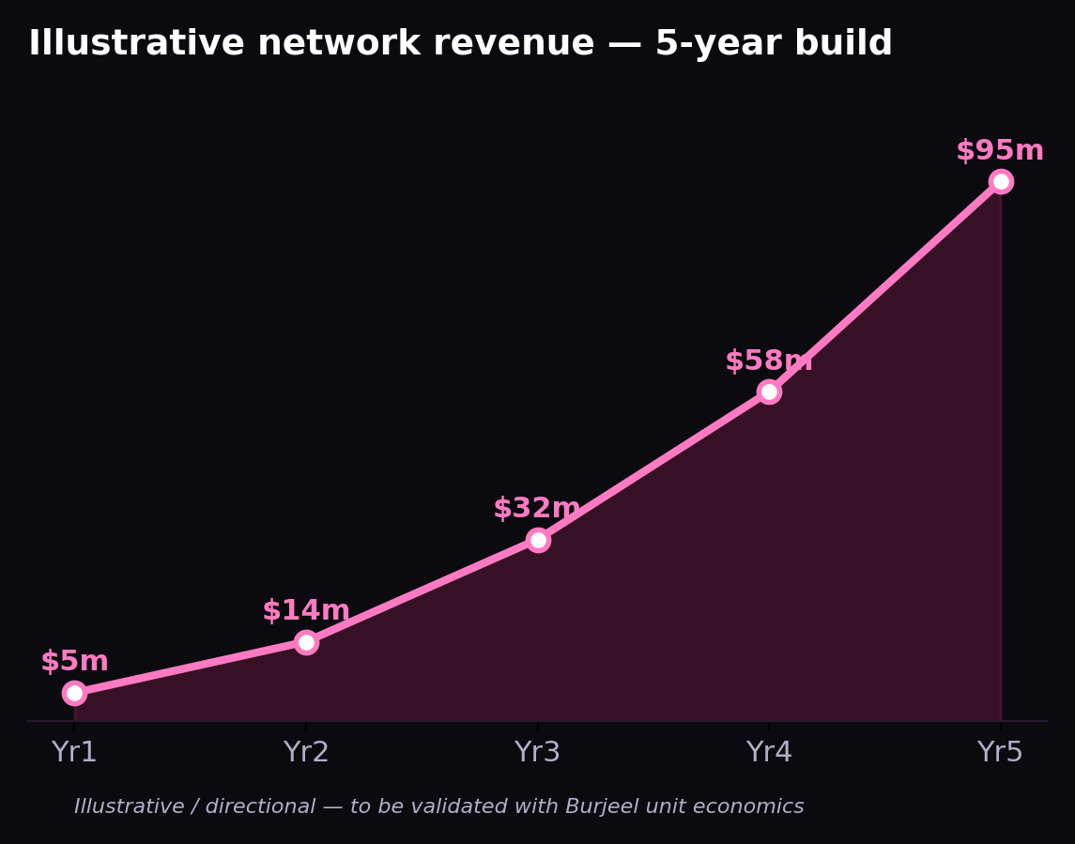
THE UPSIDE
A NETWORK THAT COMPOUNDS
Each repeatable unit lowers the cost of the next. Revenue compounds as the network scales across markets.

Slide 8
THE PLAN
A PHASED, REVERSIBLE ROLLOUT
YR 1
Tanzania
Pilot — easier entry, sovereign-PPP fit
M12
Go / No-Go
One reversible decision gate
YR 2
Kenya
Scale into the proven MES structure
YR 5
Network
Repeatable units across the continent

Slide 9
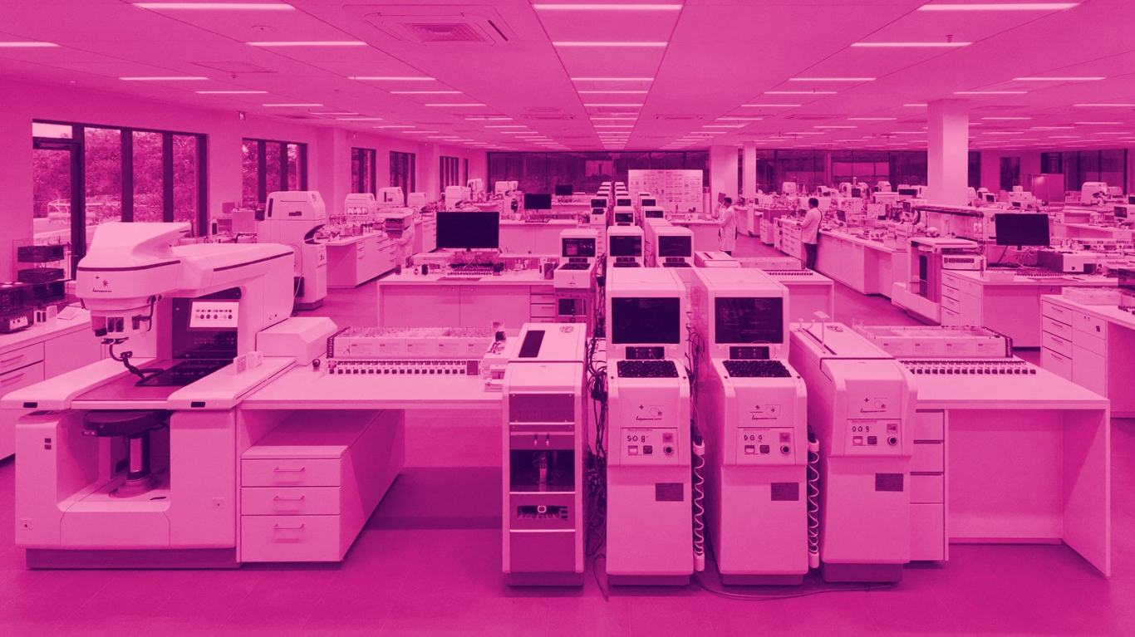
THE ASK
GREENLIGHT
ONE PILOT
ONE MARKET
Tanzania — easier entry, sovereign-PPP fit
ONE DECISION
A single Go / No-Go at month 12
ONE NEED
Dr. Shamsheer's mandate to co-develop

